Slide 1
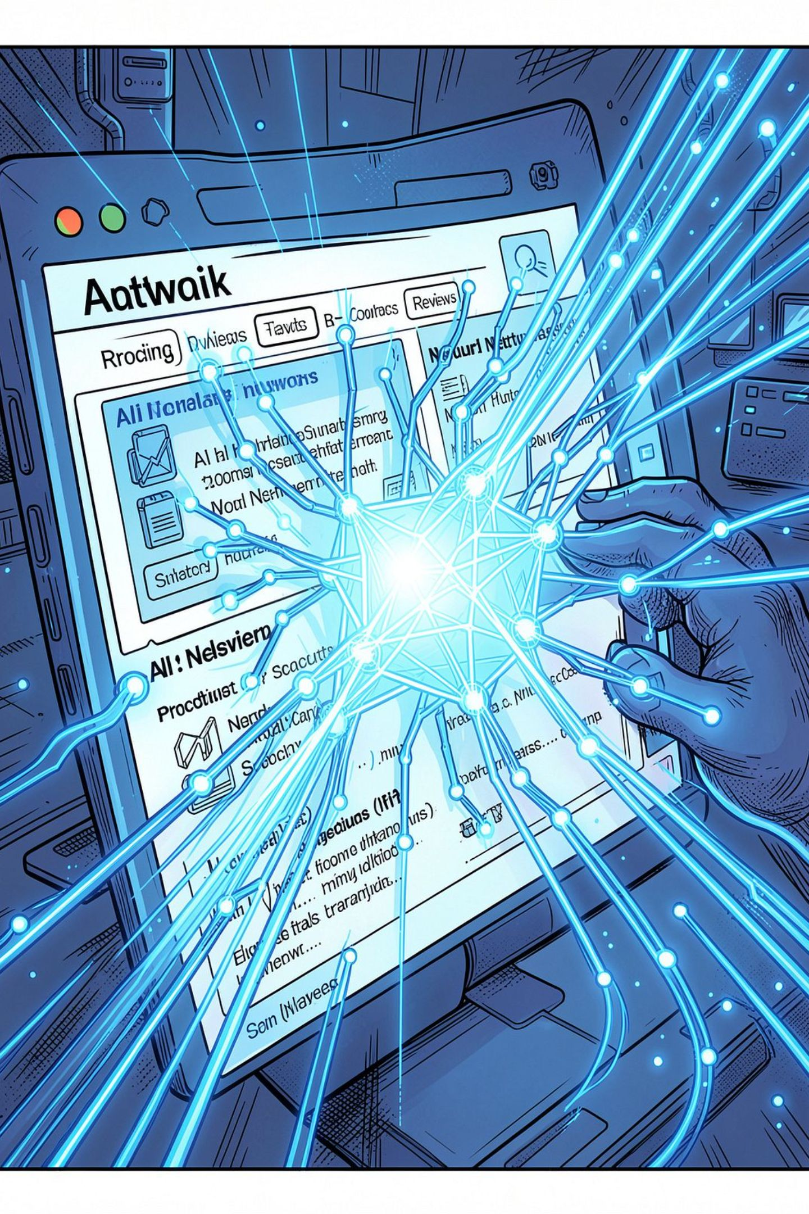
AI-Based Fake Product Review Detection & Authenticity Verification
An intelligent, AI-powered system that combats fraudulent reviews, restores customer trust, and ensures credible product ratings across e-commerce platforms.
NAME: RAVALAVALASA NISCHAL
ROLL NO: 323129510047

Slide 2
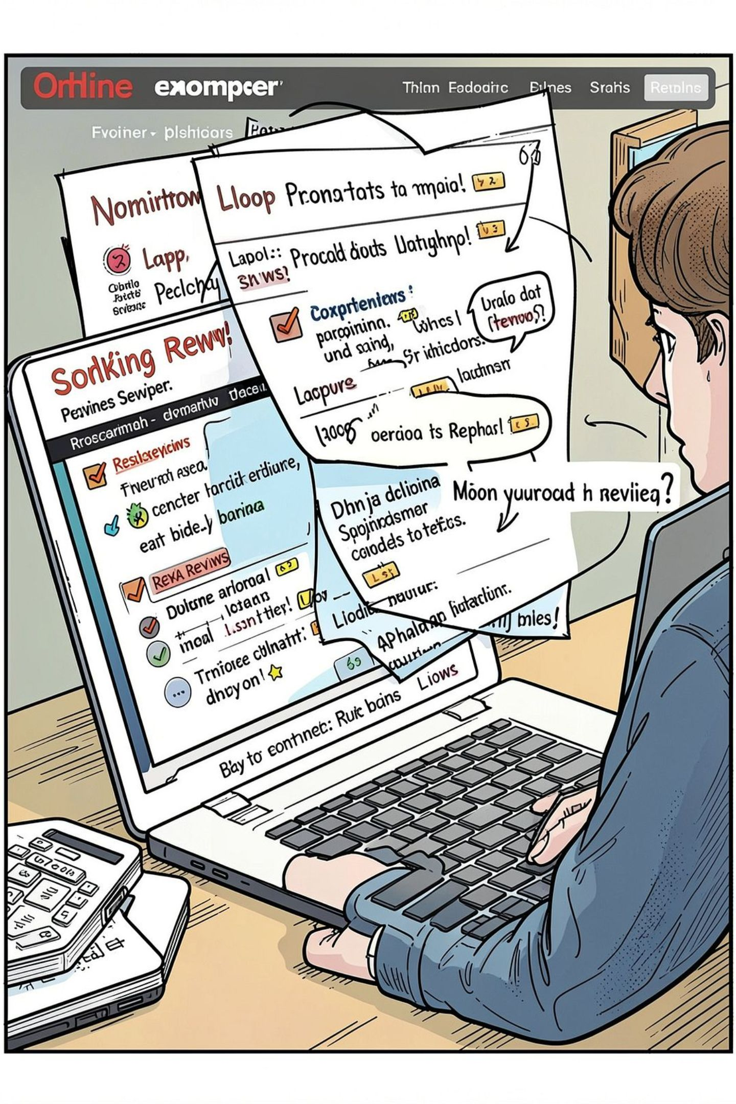
The Growing Crisis of Fake Reviews
30%
Of Online Reviews
Are estimated to be fake or manipulated globally
$152B
Annual Impact
Fake reviews cost the global economy each year
93%
Shoppers Influenced
Of consumers read reviews before making a purchase
4x
Higher Conversion
Products with verified authentic reviews convert better

Slide 3
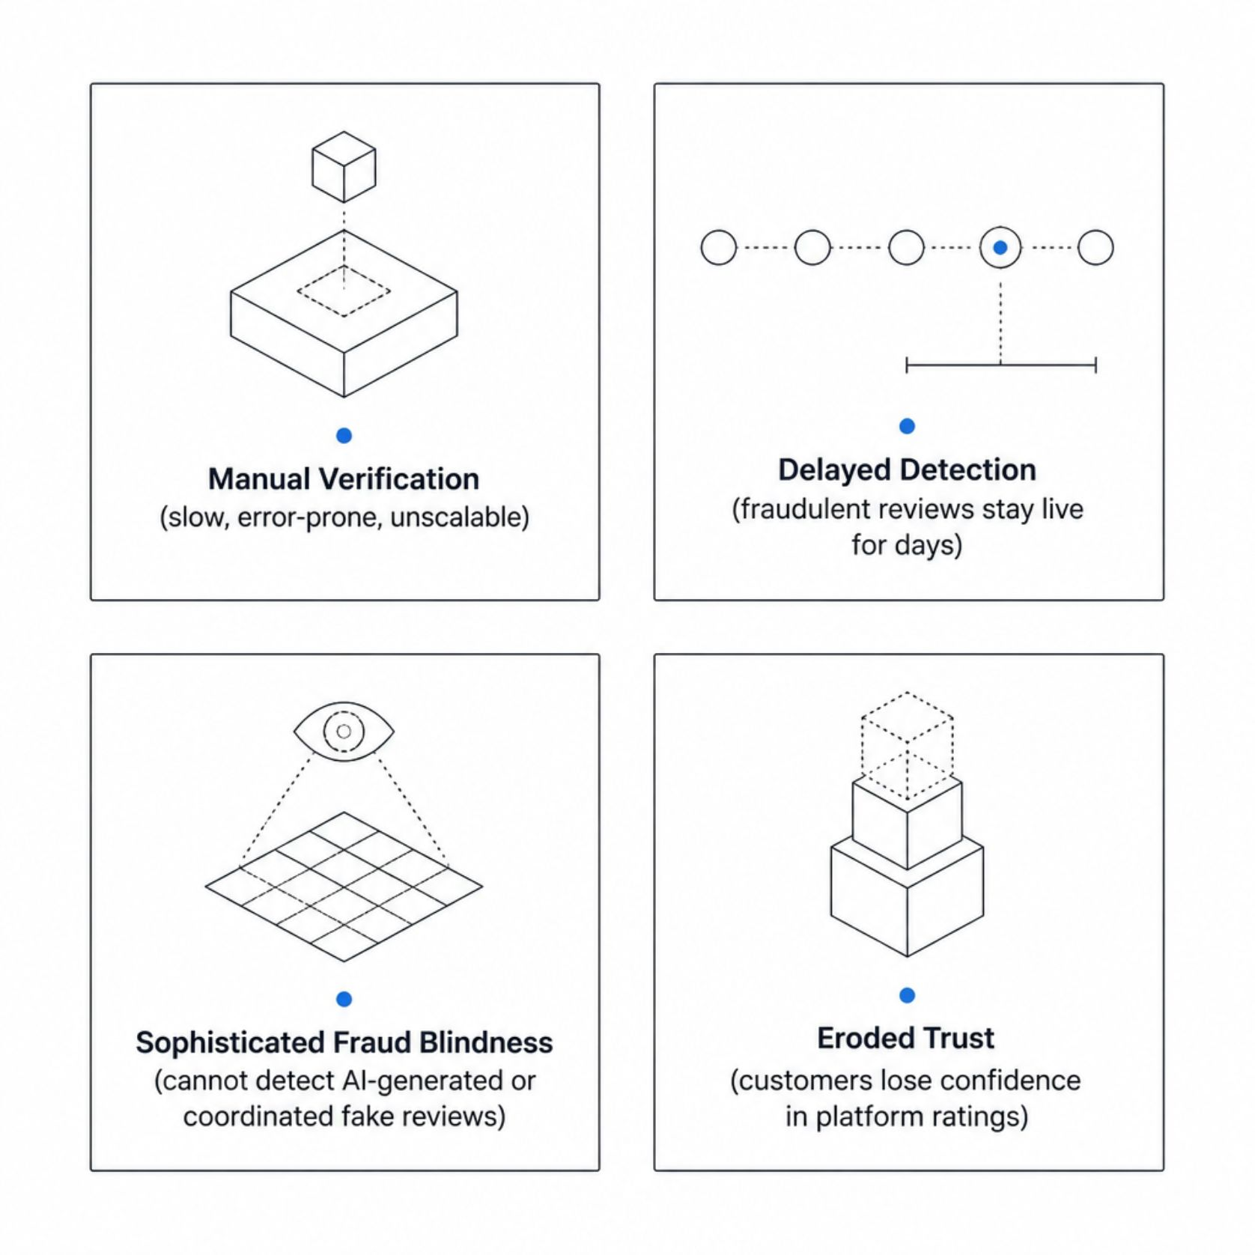
Existing Systems & Their Critical Limitations
Why Current Methods Fail
Traditional moderation relies on manual flagging and basic keyword filters — approaches that are too slow, too shallow, and too easily bypassed by sophisticated fraudsters.
High volume of reviews overwhelms human moderators
Coordinated bot networks mimic authentic writing patterns
No real-time classification or authenticity scoring
Platform credibility suffers as a direct consequence

Slide 4
Proposed System & Core Objectives
An end-to-end AI system that automatically analyzes, scores, and classifies reviews using NLP, sentiment analysis, and machine learning — in real time.
AI-Powered Detection
NLP & Sentiment Analysis
Classify reviews as genuine or suspicious using trained ML models
Evaluate linguistic features, tone, and sentiment consistency
Behavioral Analysis
Authenticity Scoring
Detect anomalous reviewer patterns and coordinated fraud
Generate real-time trust scores to guide purchasing decisions

Slide 5

System Architecture & AI Processing Pipeline
Data Collection
NLP Features
Behavior Analysis
ML Classification
Review data flows through a multi-layered AI pipeline — from raw text ingestion and preprocessing, through linguistic and behavioral feature extraction, to ML-based classification and final authenticity scoring. Suspicious reviews are flagged for moderator review before impacting product ratings.

Slide 6
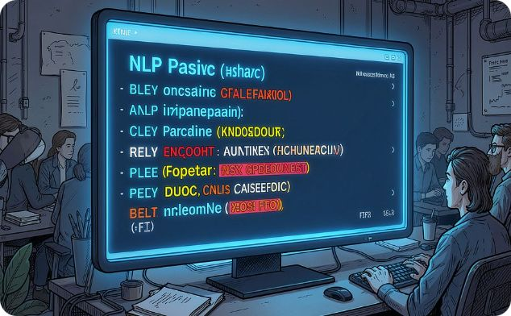
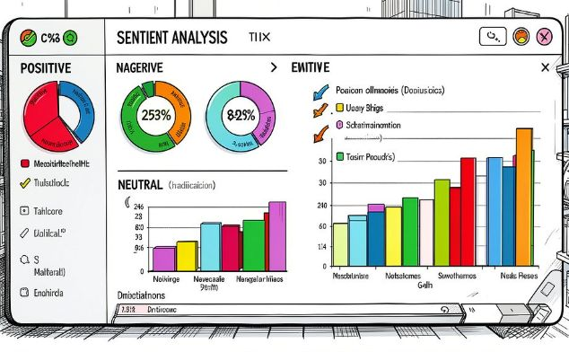
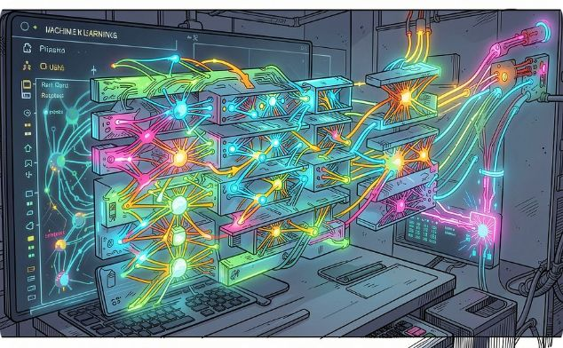
Core AI & NLP Modules
Natural Language Processing
Sentiment Analysis
ML Classification Models
Tokenization, POS tagging, and semantic parsing extract meaning, context, and intent from review text.
Detects emotional tone and flags inconsistencies — e.g., extreme positivity paired with vague product details.
Ensemble models (Random Forest, XGBoost, LSTM) trained on labeled datasets achieve high-accuracy fake review detection.

Slide 7
Review Verification Workflow
Review Submitted
Text Preprocessing
Feature Extraction
ML Classification
Every submitted review is automatically processed through the AI pipeline within seconds. Reviews scoring below the authenticity threshold are flagged for human moderator review, ensuring a balance of automation and oversight.

Slide 8
User Roles & Module Breakdown
Three User Roles
System Modules
AI Detection Module — Core ML classification engine
Review Management — CRUD operations, flagging, escalation
Analytics Dashboard — Real-time fraud trends and reports
Admin Console — Policy configuration and audit logs
Customer
Submit reviews, view authenticity badges, make informed purchases
Moderator
Review flagged content, override AI decisions, manage disputes
Administrator
Configure thresholds, monitor analytics, manage platform policies

Slide 9
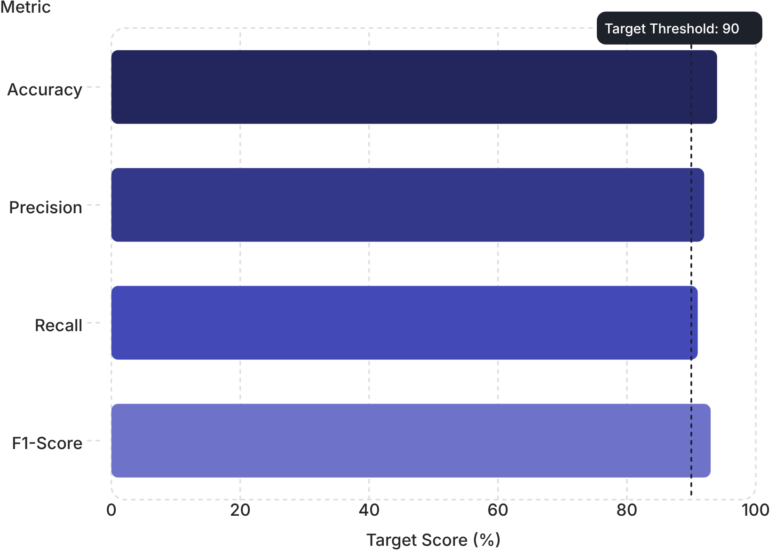
Technology Stack & Performance Metrics
Technology Stack
Target Performance Benchmarks
Backend
AI / ML
Python, Flask / Django, FastAPI
TensorFlow, Keras, Scikit-learn, spaCy, NLTK
Frontend
Database
React.js, Chart.js, Bootstrap
PostgreSQL, Redis, Elasticsearch
Target benchmarks for the ML classification model on benchmark fake review datasets (e.g., Amazon, Yelp).

Slide 10
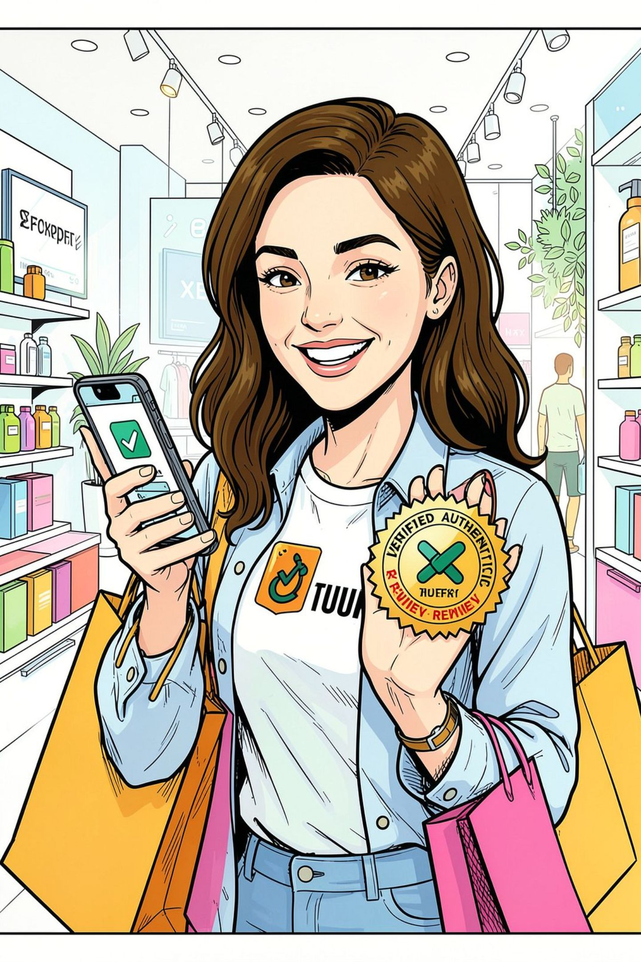

Advantages, Applications & Expected Outcomes
Enhanced Trust
Customers shop with confidence knowing reviews are AI-verified
Automated Moderation
Scalable, real-time detection reduces manual effort by up to 80%
Data-Driven Decisions
Administrators gain actionable fraud trend insights via dashboards
Scalable Applications
Deployable across marketplaces, travel sites, food delivery, and SaaS platforms
Expected Outcome: A measurable reduction in fraudulent reviews, improved platform credibility scores, and a demonstrably higher customer trust index within the first quarter of deployment.

